Slide 1


Synopsis Presentation on RESUME SCREENING SYSTEM
Guided By: Presented By:
Prof. Sanjana Sharma Anjali Bariya(0827CD221011)
Avni Chaturvedi (0827CD221018)
Lavish Verma (0827CD221045)
Yuvraj Pawar (0827CD221078)

Slide 2
Contents
Introduction
1.1 Overview
1.2 Purpose
Literature Review
Problem Statement
Proposed Solution
Objectives
Theoretical Analysis
6.1 Block Diagram
6.2 Hardware Requirements
6.3 Software Requirements
Applications
REFERENCES

Slide 3
1. Introduction
1.1 Overview
We provide services to enhance resume quality and relevance by analyzing resumes against specific job descriptions. Our approach includes identifying missing keywords and skills essential for the role, ensuring that your resume aligns closely with what employers are seeking. Additionally, we optimize resumes for ATS compatibility, focusing on formatting, section headings, and keyword usage to improve your chances of getting noticed in the application process.
1.2 Purpose
Our service streamlines the resume tailoring process for job seekers by effectively matching resumes with employers' desired qualifications. This targeted approach increases the chances of being shortlisted for interviews. Additionally, we provide tailored suggestions for potential interview questions based on specific job descriptions, helping candidates prepare more effectively and confidently.

Slide 4
2. Literature Review
Sr. No. | Name of Solution/System | Features | Limitations/ Drawbacks
01 | Modern Resume Analyser For Students And Organisations | Aims to enhance the efficiency of candidate screening and selection processes | Potential introduction of biases or the oversight of unconventional qualifications or experiences
02 | Applicant Helper System for Resume Using Python And NLP | System aims to extract relevant information such as skills, experiences, and qualifications. | System's performance degradation with poorly formatted or misspelled terms

Slide 5
3. Problem Statement
In today's competitive job market, candidates often struggle to tailor their resumes to meet specific job requirements, leading to missed opportunities due to the absence of critical keywords or skills that align with job descriptions. Traditional resume-building tools lack personalized, real-time feedback, leaving candidates uncertain about how well their resumes match job requirements. This creates a disadvantage for job seekers who may not know how to optimize their resumes effectively for specific roles. Therefore, there is a need for a Resume Screening System that provides detailed analysis of resumes against job descriptions, identifying missing keywords, evaluating relevant skills, and calculating a percentage match.

Slide 6
4. Proposed Solution
The Resume Screening System is a comprehensive tool designed to assist job candidates in optimizing their resumes to align with specific job requirements. By allowing users to upload their resume and paste the job description, the system analyzes both documents to identify missing keywords, assess relevant skills, and calculate a percentage match between the resume and the job posting. This candidate-focused system offers real-time feedback, helping users enhance their resumes by suggesting improvements and providing actionable insights. Additionally, it generates detailed reports that guide candidates in making their resume more competitive and tailored for the job, ultimately improving their chances of success.

Slide 7
5. Objectives
Automate the initial resume screening process to increase efficiency.
Reduce bias in candidate selection by standardizing resume evaluation.
Improve the accuracy of matching candidates to job descriptions.
Integrate with existing HR systems for seamless recruitment management.
Enhance the candidate experience by providing timely feedback.

Slide 8
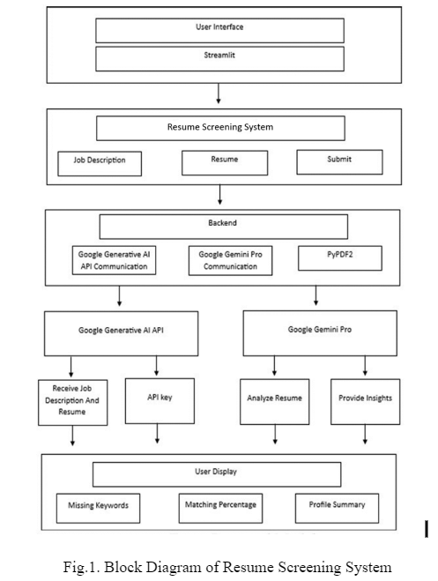
6. Theoretical Analysis 6.1 Block Diagram

Slide 9
6. Theoretical Analysis
6.2 Hardware Requirements
RAM- min 8GB and ideal 32 GB
Storage- minimum 256 GB SSD and ideal 1 TB
2GHz dual core processor or better
Operating System- Windows 8 (64 bit) or better
6.3 Software Requirements
Programming Language: Python 3.9
Framework: Streamlit (for creating the web interface)
Libraries:
pypdf2 (to open and delete the pdf)
Generative AI from Google (for processing and generating insights from resumes)
APIs and Services:
Google Generative AI API: Used for AI-based resume analysis and matching candidates with job descriptions
Google gemini pro communication: For communication between the front-end (Streamlit interface), back-end, database
Database: SQL or NoSQL (like MySQL or MongoDB) for storing resumes, candidate profiles, and job descriptions

Slide 10
7. Applications
Corporate Job Portals
Interactive Guidance
Career Services at Universities
Internal Job Mobility
Campus Recruitment
Talent Acquisition for Specialized Roles
Volunteer Organizations

Slide 11
GitHub Link
https://github.com/Lavish-Verma/Resume-Screening-System.git

Slide 12
REFERENCES
Prof. P.R. Kulkarni, Yash Vaidya, Akshad Shelare, Narayan Attarde, Meet Sali, “Resume Parser Using ML and NLP”, International Research Journal of Modernization in Engineering Technology and Science (IRJMETS), 2023.
S Bharadwaj, Rudra Varun, Potukuchi Sreeram Aditya, Macherla Nikhil, G. Charles Babu, “Resume Screening Using NLP And LSTM”, 2022 International Conference on Inventive Computation Technologies (ICICT), 2022.

Slide 13
Thank You
Queries ?

